Slide 1
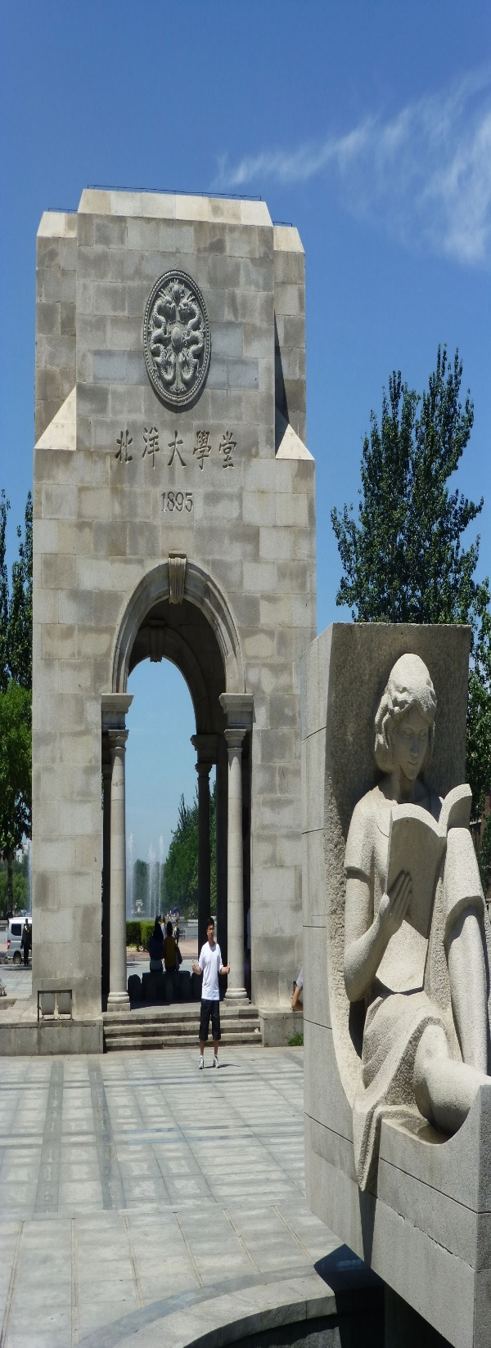

TRIZ
Innovative Theory Method and Ecological Civilization Practice - Presentation
Catherine B. Merchant - 6317000091

Slide 2
The Outline
Introduction
The Key TRIZ Tools
39 Engineering Parameters
40 Inventive Principles
How To Use TRIZ Principles
Conclusion

Slide 3
Introduction
What is TRIZ? Theoria Resheneyva Isobretatelskehuh Zadach - (TRIZ)
TRIZ is the Russian acronym for the "Theory of Inventive Problem Solving," an international system of creativity developed in the U.S.S.R. between 1946 and 1985, by engineer and scientist Genrich S. Altshuller and his colleagues.
According to TRIZ, universal principles of creativity form the basis of innovation. TRIZ identifies and codifies these principles, and uses them to make the creative process more predictable.
In other words, whatever problem you're facing, somebody, somewhere, has already solved it (or one very like it). Creative problem solving involves finding that solution and adapting it to your problem.
TRIZ is most useful in roles such as product development, design engineering, and process management. For example, Six Sigma quality improvement processes often make use of TRIZ.
TRIZ (The Theory of Inventive Problem Solving) is a systematic approach for understanding and solving any problem and a catalyst for innovation and invention

Slide 4
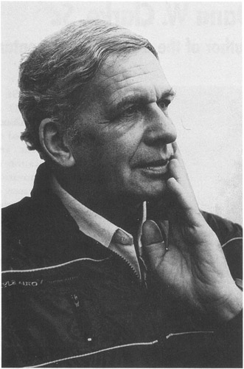
Genrich S. Altshuller
Introduction
Born October 15, 1926
Died September 24, 1998
Born in Tashkent, Uzbek SSR, USSR
a Soviet engineer, inventor, scientist, journalist and writer.
He is most notable for the creation of TRIZ.
He founded the Azerbaijan Public Institute for Inventive Creation, and was the first President of the TRIZ Association.
He also wrote science fiction under the pen-name Genrikh Altov.
Introduction

Slide 5
The Key TRIZ Tools
Let's look at two of the central concepts behind TRIZ: generalizing problems and solutions, and eliminating contradictions.
1. Generalizing Problems and Solutions
The primary findings of TRIZ research are as follows:
Problems and solutions are repeated across industries and sciences. By representing a problem as a "contradiction", you can predict creative solutions to that problem.
Patterns of technical evolution tend to repeat themselves across industries and sciences.
Creative innovations often use scientific effects outside the field where they were developed.

Slide 6
The Key TRIZ Tools
Using TRIZ consists of learning these repeating patterns of problem and solution, understanding the contradictions present in a situation, and developing new methods of using scientific effects.
You then apply the general TRIZ patterns to the specific situation that confronts you, and discover a generalized version of the problem.
GENERAL APPROACH TO PROBLEM SOLVING
Analogous Problem
Analogous Solution
My Problem
My Solution

Slide 7
The Key TRIZ Tools
2. Eliminating Contradictions
Another fundamental TRIZ concept is that there are fundamental contradictions at the root of most problems. In many cases, a reliable way to solve a problem is to eliminate these contradictions.
TRIZ recognizes two categories of contradictions:
Technical contradictions. These are classical engineering "trade-offs," where you can't reach the desired state because something else in the system prevents it. In other words, when something gets better, something else automatically gets worse. For example:
The product gets stronger (good), but the weight increases (bad).
Service is customized to each customer (good), but the service delivery system gets complicated (bad).
Training is comprehensive (good), but it keeps employees away from their assignments (bad).

Slide 8
The Key TRIZ Tools
The key technical contradictions are summarized in the TRIZ CONTRADICTION MATRIX . As with all TRIZ resources, it takes time and study to become familiar with the Contradiction Matrix.
Physical (or "inherent") contradictions. These are situations in which an object or system suffers contradictory, opposite requirements. Everyday examples include:
Software should be complex (to have many features), but simple (to be easy to learn).
Coffee should be hot (to be enjoyed), but cool (to avoid burning the drinker).
An umbrella should be large (to keep the rain off), but small (to be maneuverable in a crowd).
You can solve physical contradictions with the TRIZ SEPERATION PRINCIPLES. These separate your requirements according to basic categories of Space, Time and Scale.

Slide 9
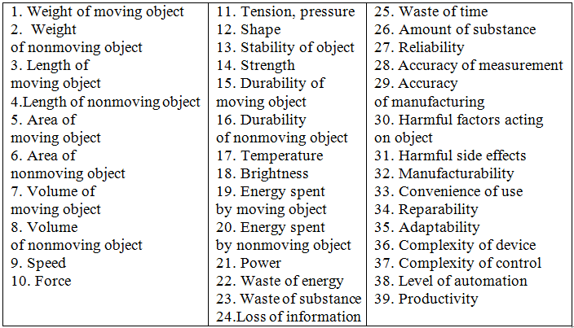
39 ENGINEERING PARAMETERS

Slide 10
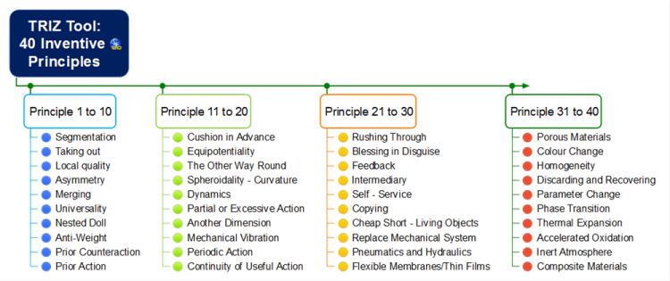
40 INVENTIVE PRINCIPLES

Slide 11
How to Use TRIZ Principles
Begin to explore TRIZ by applying it to a simple, practical problem.
A New Structural Material for Bullet Proof Garment
Statement: Bullet proof vests should be strong, but not heavy.
Step 1 – Identify the contradiction(s)
Strength (improves) versus
Weight (worsens)
Step 2 – Look at the list of features and identify those important to your contradiction.
Strength – #14
Weight – #2
Step 3 Identify Which Are Improving Features and Which Are Worsening Features
Strength (feature 14) improves
Weight (feature 2) worsens

Slide 12
Conclusion
TRIZ is a system of creative problem solving, commonly used in engineering and process management. It follows four basic steps:
Define your specific problem.
2. Find the TRIZ generalized problem that matches it.
3. Find the generalized solution that solves the generalized problem.
4. Adapt the generalized solution to solve your specific problem.
Most problems stem from technical or physical contradictions. Apply one of hundreds of TRIZ principles and laws to eliminate these contradictions, and you can solve the problem.

Slide 13
THANK YOU!!

